Slide 1
NTP and Evil
Geoff Huston, Randy Bush

Slide 2
The Evolution of Evil
It used to be that you sent evil packets to your chosen victim
  but this exposed you, and limited the damage you could cause
e.g. TCP SYN attack
Attacker
Victim

Slide 3
The Evolution of Evil
Then you enrolled a bot army to send evil
  which kept you hidden and increased the damage leverage
Attacker
Victim
Massed connection attempts

Slide 4
The Evolution of Evil
But now you co-opt the innocent into the evil cause, and use uncorrupted servers to launch the attack
  which hides the attacker(s) and uses the normal operation of servers to cause damage

Slide 5
UDP is a Fine Protocol
UDP is used whenever you want a fast and highly efficient short transaction protocol
Send a query to a server ( one packet)
And the server sends an answer (one packet)
UDP works best when the question and the answer are small (<512 bytes), but can work on larger transactions*
Although it’s not as reliable as TCP
*
The fine print (yes, you‘ll need to magnify this to read it!)
Some UDP applications use multiple UDP packets for large answers (e.g. NTP). Some rely of IP level fragmentation (e.g. DNS with EDNS0)
The problem with relying on fragmentation is firewall filtering and NATs (the trailing frags have no transport level header to assist in locating the NAT binding , as fragmentation is an IP level function)
And the problem with multiple UDP packets is that the onus for reliable reassembly is pushed into the application, which may not necessarily do this well!, And the sender tends to barf large packet trains with no flow control, which can be bad as well

Slide 6
UDP Mutation
Unlike TCP there is no handshake between the two parties
  Send the server a UDP packet
  The server flips the source and destination IP addresses and responds with a UDP packet
  The server never checks the authenticity of the source address
This allows a simple reflection attack

Slide 7
UDP Reflection Attack
Server
Proto: UDP
Dest: Server
Source: Victim
Proto: UDP
Dest: Victim
Source: Server
Attacker
Victim
note fake source!

Slide 8
UDP and DDOS Reflection Attacks
This works “best” for a UDP-based service when:
  The service is widely used
  Servers are commonplace
  Servers are poorly maintained (or unmaintained)
  Clients are not “qualified” by the server (i.e. anyone can pose a query to a server)
  The answer is far bigger than the question

Slide 9
Hmmmmm
What could that be?

Slide 10
The DNS!!!
  UDP-based query response service
    UDP is now almost ubiquitous for the DNS – EDNS0 wiped out the last vestiges of TCP fallback for most DNS resolvers
  The service is widely used
    Everybody is a client of the DNS
  Servers are commonplace
    Resolvers are scattered all over the Internet
  Servers are poorly maintained (or unmaintained)
    There are some 30 million open resolvers
  Clients are not “qualified” by the server (i.e. anyone can pose a query to a server)
    authoritative DNS name servers are promiscuous by design
    Many DNS resolvers are unintentionally promiscuous
  The answer is be far bigger than the question
    Just ask the right DNS question!

Slide 11

Co-Opting the DNS for Evil
DNS DDOS attacks are now very commonplace
They can (and do) operate at sustained gigabit speeds
Efforts to mitigate tend to degrade the quality of the service as well as affecting the victim

Slide 12
What other UDP services are susceptible?
chargen?
snmp?

Slide 13
It’s as easy as 1, 2, 3!
NTP is a simple UDP query/ response protocol, where the NTP server listens on UDP port 123
Time is important for network-distributed services
So we’ve deployed a lot of NTP servers to distribute time across the network

Slide 14
NTP and UDP Reflection Attacks
  UDP-based query response service
    UDP is ubiquitous for NTP
  The service is widely used
    Time is widely distributed
  Servers are commonplace
    NTP servers are scattered all over the Internet
  Servers are poorly maintained (or unmaintained)
    NTP tends to be operated in a “configure and forget” mode
  Clients are not “qualified” by the server (i.e. anyone can pose a query to a server)
    NTP is not necessarily promiscuous
    But it is often configured in a promiscuous mode
  The answer is far bigger than the question
    Not normally…

Slide 15
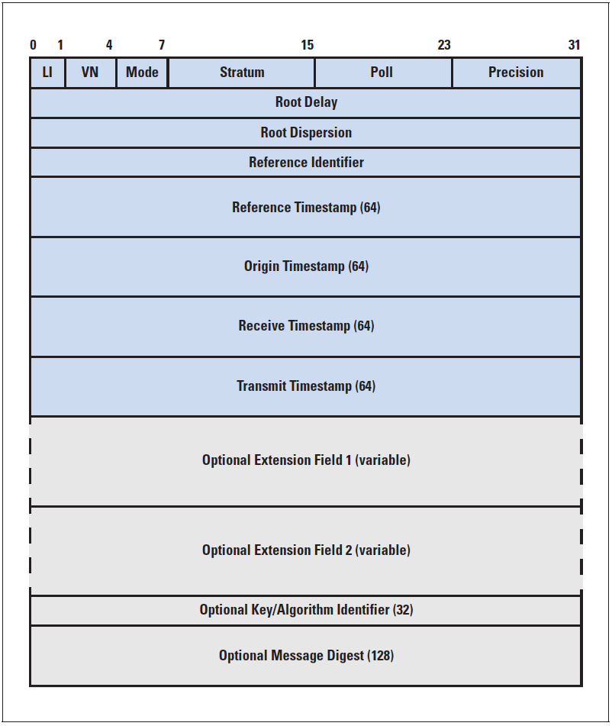

NTP transactions are symmetric
76 octets
The same packet is passed from client to server and
back again, with local clock values added into the
NTP PDU as the PDU is sent and received
server
client
76 octets

Slide 16
NTP
The NTP server’s time response is the same size as the NTP time query
    Which limits the types of attacks that are effective, as this becomes indirection rather than indirection + amplification
But the NTP folk added another hook into the model
  The NTP command and control channel is also implemented in UDP, using the same UDP port

Slide 17
NTP
The NTP server’s time response is the same size as the NTP time query
    Which limits the types of attacks that are effective, as this becomes indirection rather than indirection + amplification
But the NTP folk added another hook into the model
  The NTP command and control channel is also implemented in UDP, using the same UDP port
Ooops!

Slide 18
NTP Command and Control
ntpdc – the “special” NTP query program
  “monlist” returns the IP addresses of the last (up to) 600 systems that this NTP server has interacted with
    ntpdc –c monlist <server>
  (There are other commands, but “monlist” provides the highest amplification)
  One UDP packet of 220 bytes input generates up to
  100 x 468 byte UDP packets in response
  That’s an impressive amplification factor of 212!)

Slide 19
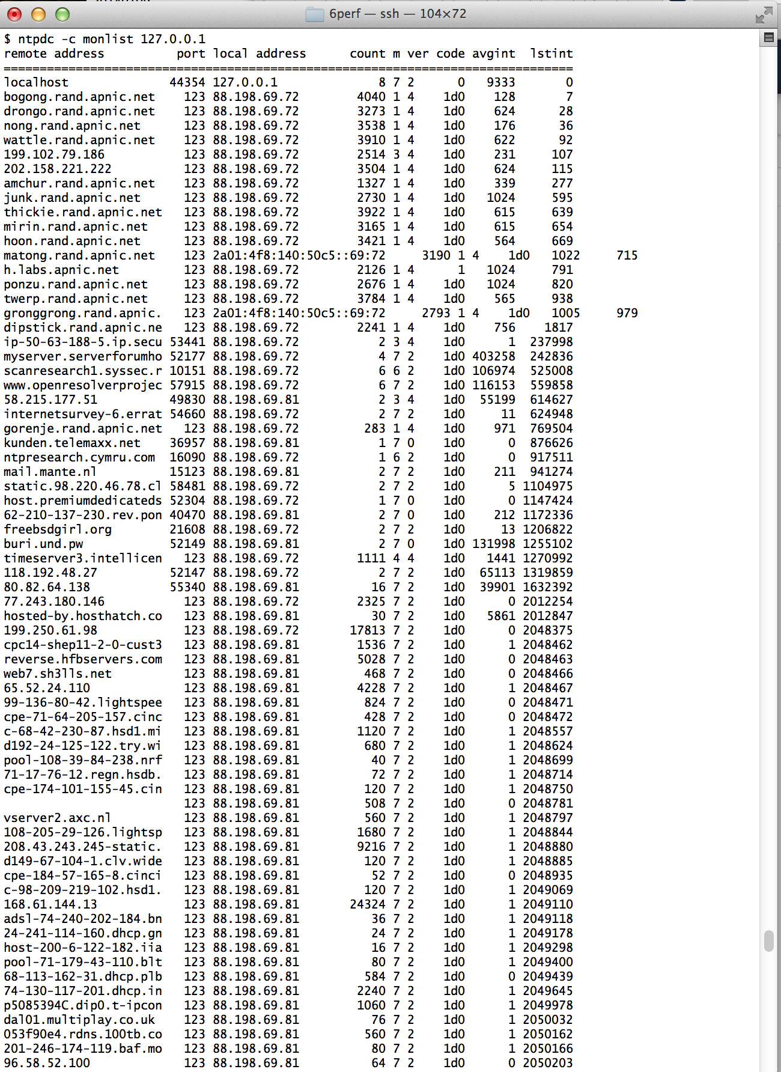
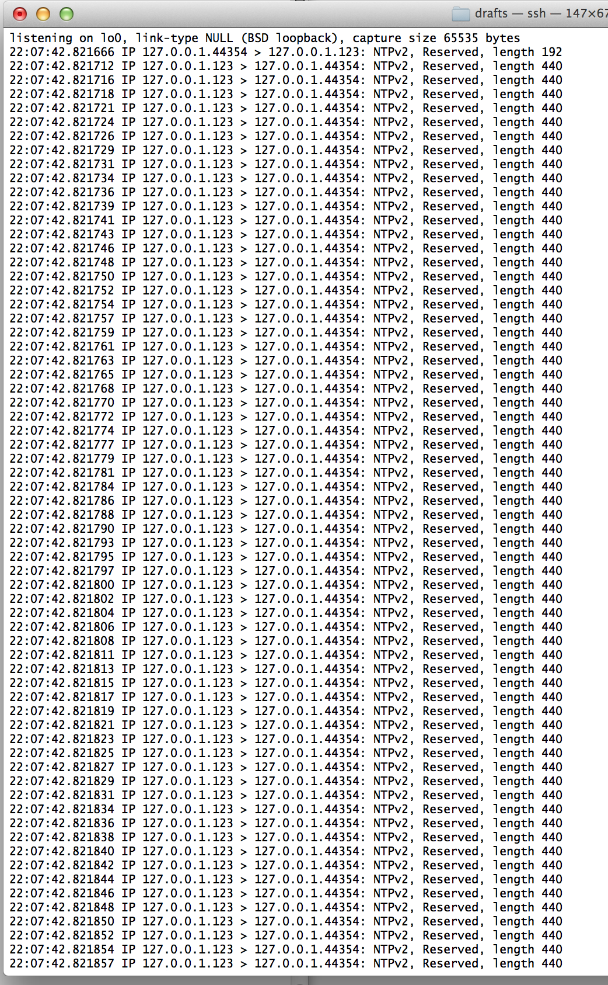

Slide 21
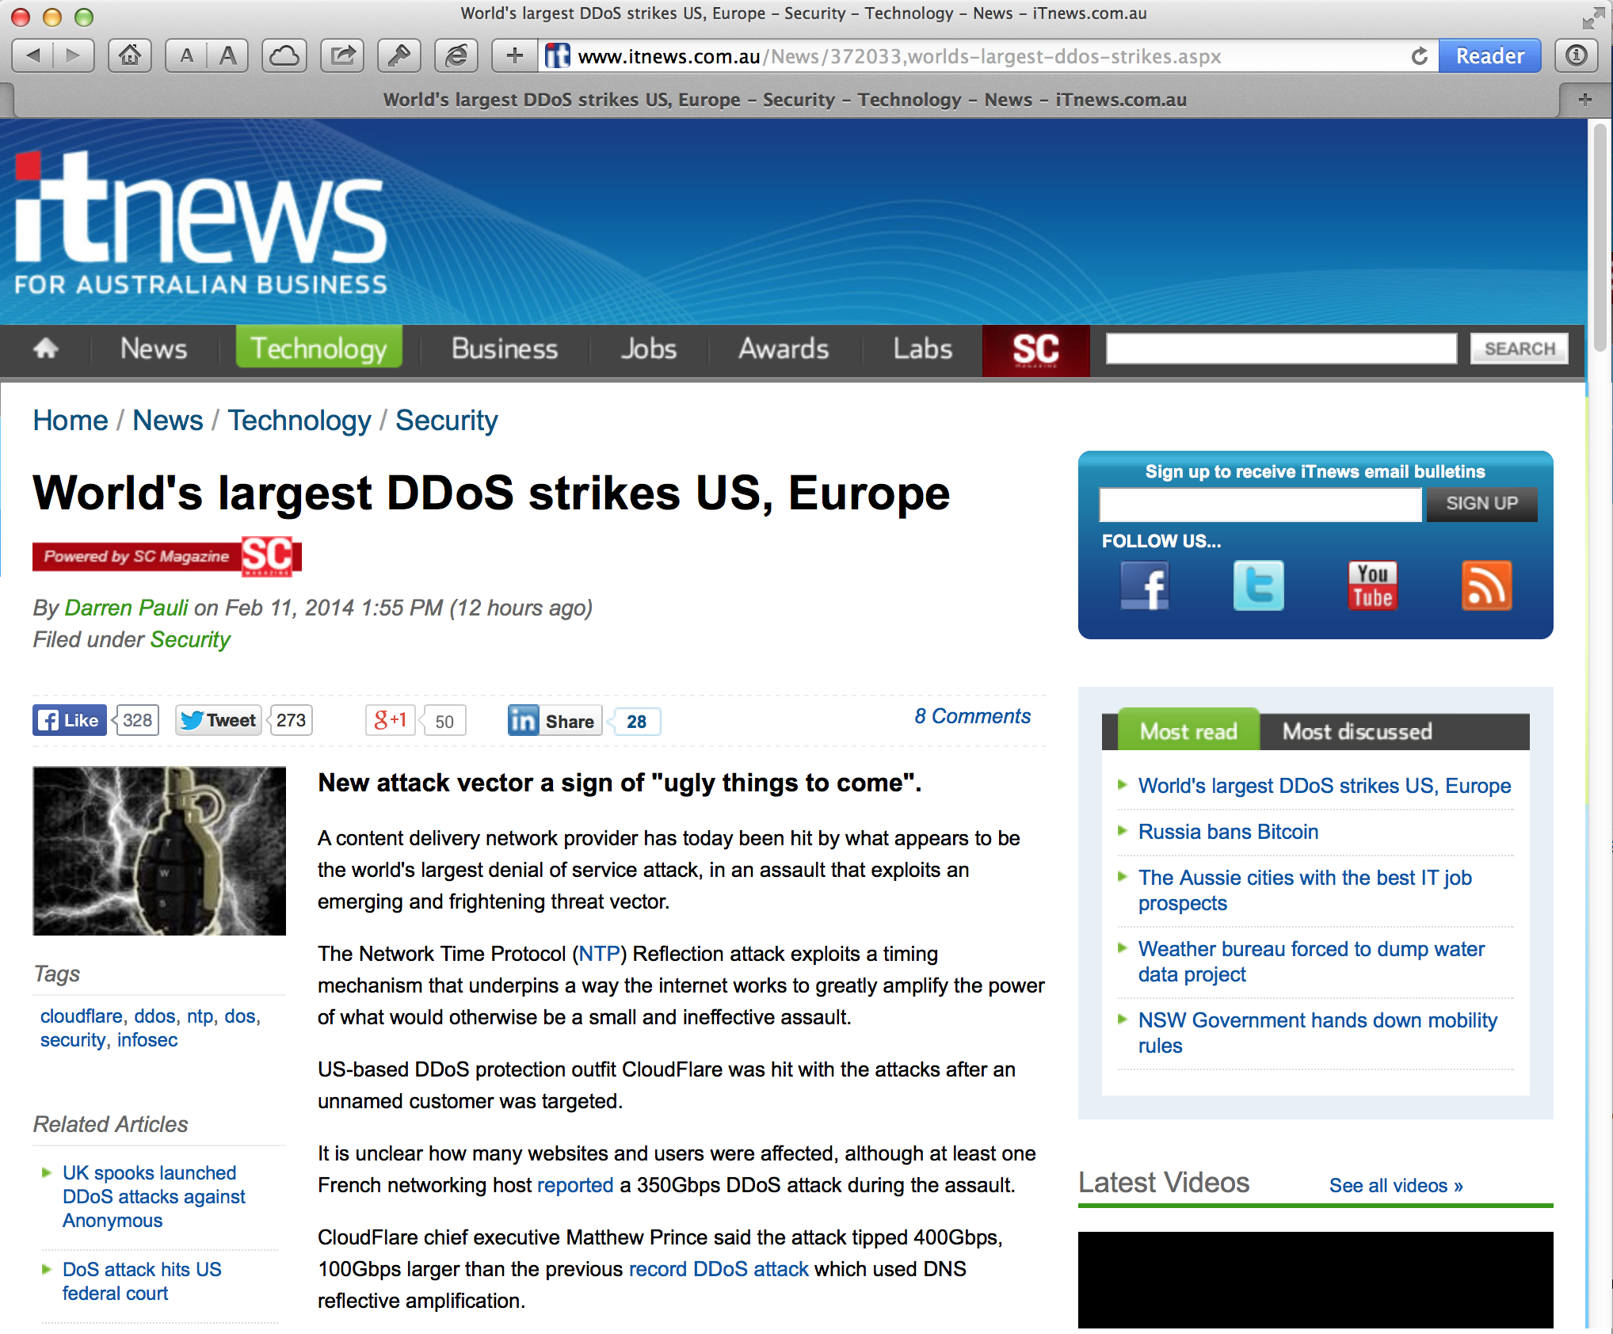

Slide 22

What you need to be naughty
To Do List
Generate a list of open NTP hosts (zmap, for example is a good starting point)
Write a simple script that sends monlist commands to the open server, with UDP source address spoofing
Enlist some coercible hosts to generate some 2,500 monlist queries per second
And the servers will respond with a 1Gbps DDOS stream!
Rinse, repeat and multiply

Slide 23
What you need to be nice
Seal up your NTP
  The following Team Cymru’s secure template for NTP should help:
    http://www.team-cymru.org/ReadingRoom/Templates/secure-ntp-template.html
Disable monlist
  Upgrade NTP to at least version 4.2.7p26

Slide 24
Being Nice on a (cisco ios) Router
ios (recent 12.* releases)
access-list 46 remark utility ACL to block everything
access-list 46 deny any
!
access-list 47 remark NTP peers/servers we sync to/with
access-list 47 permit 10.0.0.1
access-list 47 permit 10.0.0.2
access-list 47 deny any
!
! NTP access control
ntp access-group query-only 46 ! deny all NTP control queries
ntp access-group serve 46 ! deny all NTP time and control by default
ntp access-group peer 47 ! permit sync to configured peer(s)/server(s)
ntp access-group serve-only 46 ! deny NTP time sync requests

Slide 25
Being Nice on a (cisco xr) Router
ios/xr
Ntp
server 10.0.0.1
Server 10.0.0.2
source Loopback0
update-calendar
!
! local packet transport service config
lpts pifib hardware police location 0/2/CPU0
flow ntp default rate 0
flow ntp known rate 64
!
! The input/loopback filter for xr
control-plane
management-plane
inband
interface all
!!! oh, no config here for ntp, I guess LPTS handles it all?

Slide 26
Being Nice on a (juniper) Router
This is a firewall filter fragment for a loopback filter which assumes a default permit
The alternative is to use a loopback default deny filter, in which case you would need the inverse form of the filter to accept NTP packets from the configured servers:
term ntp {
from {
source-address {
10.0.0.1/23;
10.0.0.2/32;
}
protocol udp;
port ntp;
}
then {
count ntp-requests;
accept;
}
}
juniper
term ntp {
from {
source-address {
0.0.0.0/0;
/* NTP servers to get time from */
10.0.0.1 except;
10.0.0.2 except;
}
protocol udp;
port ntp;
}
then {
discard;
}
}

Slide 27
Being nice on a host
/etc/ntp.conf
# By default, exchange time with everybody, but don't allow
# configuration.
#
restrict -4 default kod notrap nomodify nopeer noquery
restrict -6 default kod notrap nomodify nopeer noquery
#
# Local users may interrogate the ntp server more closely.
restrict 127.0.0.1
restrict ::1

Slide 28
But…
Being nice is not always possible
  There is a significant volume of embedded functionality in appliances and consumerware
  And enough of it includes NTP to be a problem that is not going to be “fixed” anytime soon
Which leads to the underlying observation:
  that despite more than 15 years of lip service, without much actual support in our networks, Source Address Filtering really IS important!

Slide 29
How to be nice to each other
Perform Source Address Validation filtering on all outgoing ports
  i.e. deploy BCP38 in your network!

Slide 30
Some Useful Resources
NTP Monlist command:
  http://www.eecis.udel.edu/~mills/ntp/html/ntpdc.html
Description of NTP attack
  http://blog.cloudflare.com/understanding-and-mitigating-ntp-based-ddos-attacks
Sealing up NTP – a template for ntp.conf
  http://www.team-cymru.org/ReadingRoom/Templates/secure-ntp-template.html
Open NTP servers
  http://openntpproject.org
BCP 38
  http://bcp38.info
BCP 38 tracking
  http://spoofer.cmand.org//

Slide 31
Thanks!

