Slide 1
Internet Resilience
Geoff Huston AM
Chief Scientist, APNIC

Slide 2
How?
Do we incorporate resilience into the Internet’s infrastructure, protocols and applications?
What are the practical limits on engineering resilience?

Slide 3
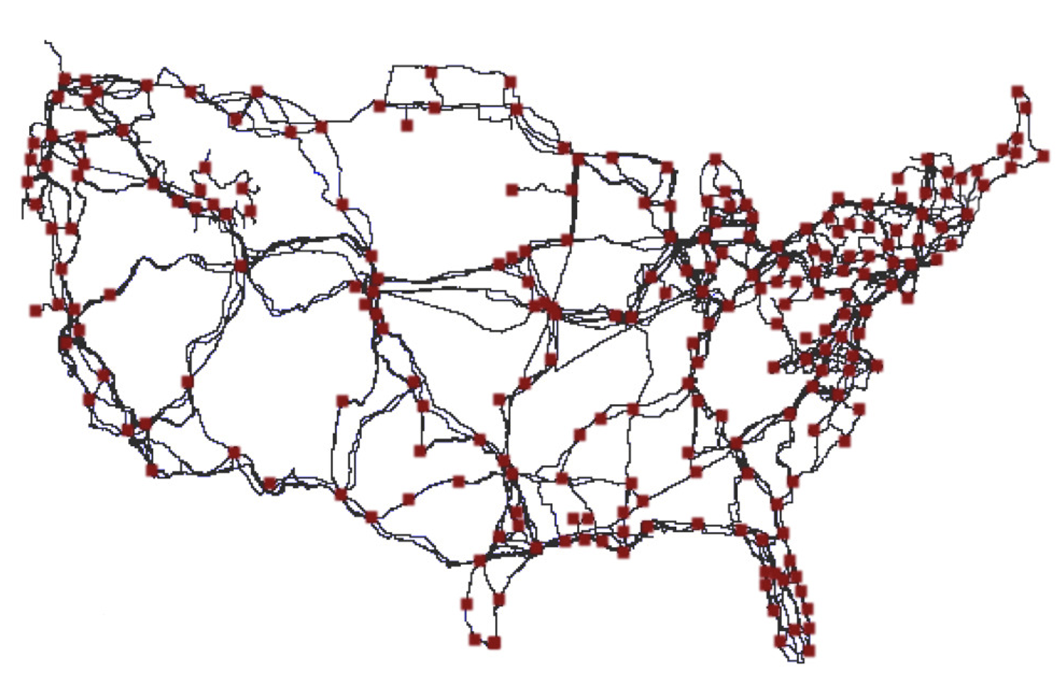
Transmission Reslience
How do you protect cable systems?
  Use a mesh of internal connectivity such that each node is connected to 2 or more other nodes
  Use a control system that can detect inter-node link failures and re-direct data flows around the failure
https://pages.cs.wisc.edu/~pb/tubes_final.pdf

Slide 4
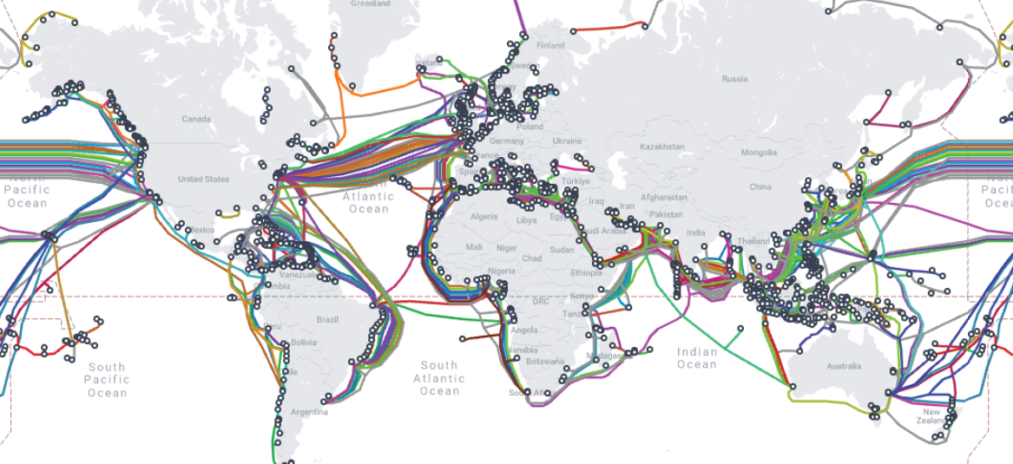
Transmission Resilience
How do you protect undersea cable systems?
  By using a large collection of cables so that no single cable becomes a single point of vulnerability
Map: Telegeography

Slide 5
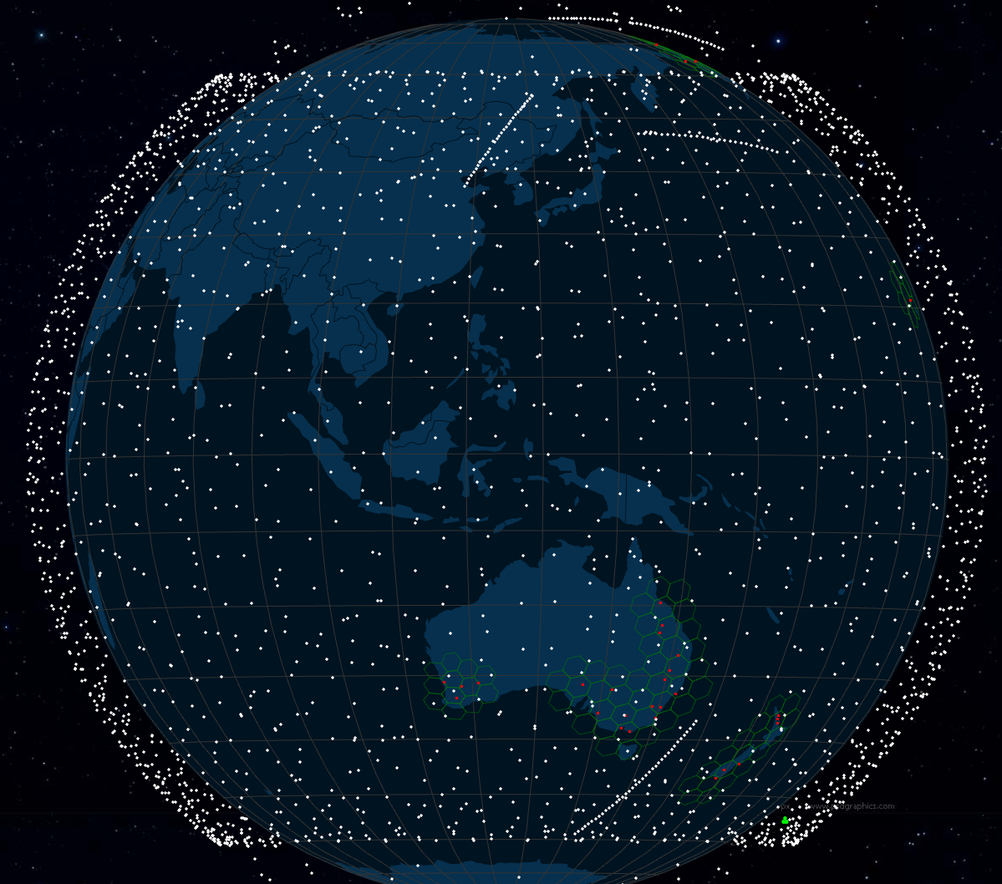
Transmission Resilience
Low Earth Orbiting services
  These compound systems can perform mutual backup across the satellite constellation – no single satellite is critical to the service
satellitemap.space

Slide 6
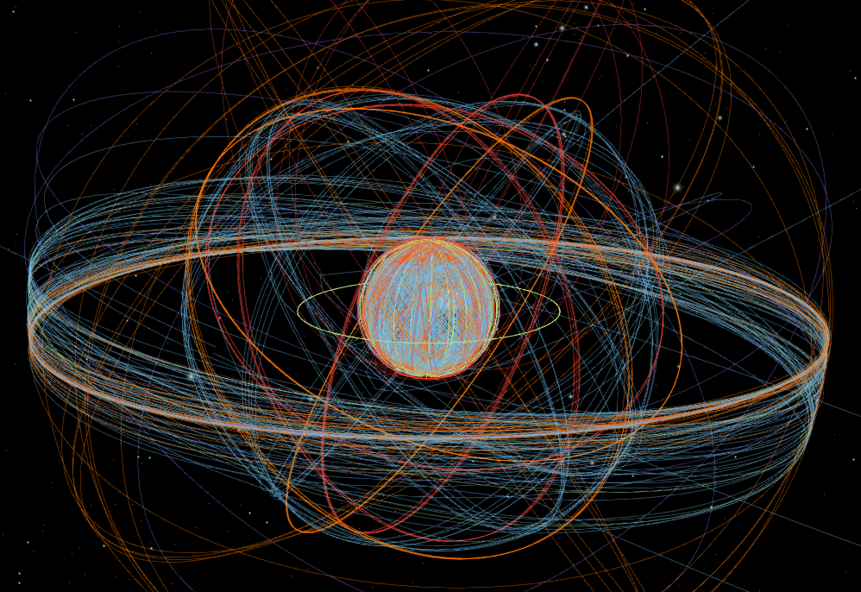
Transmission Resilience
MEOs and GEOs
  Higher altitude spacecraft do not operate in a dense mesh so they generally do not offer mutual backup
  They can complement terrestrial systems by offering a space-based path as a backup
https://geoxc-apps.bd.esri.com/space/satellite-explorer/

Slide 7
How to support transmission resilience
It you have a self-repairing transmission system, then the issue becomes how to redirect data flows along new paths when failure occurs
Stateful virtual circuit systems have a more challenging task here as they have to reload a coherent set of forwarding directives to restore virtual circuit integrity
Stateless packet-based forwarding systems can respond more directly to dynamic changes in the network’s internal topology

Slide 8
Datagram Packet Networking
By allowing each node greater ability to determine how to handle individual communications elements packet-based networks can be used in systems that are resilient against many forms of node and link failure
  as long as the basic connectivity infrastructure is sufficiently dense
Constructing a network using a packet-based foundation, is possible to construct a highly resilient and reliable system from less reliable components

Slide 9
Packet Networking
Divide a communications stream into a sequence of individual “packets”
Add the intended destination as an addresses to each packet’s header, together with a sequence identifier and pass the packet into the network
Allow the destination to reassemble the communications stream from the sequencing information in the received packets
Each packet in an independent transaction, and packet loss can be repaired individually
The network has no end-to-end virtual state to support the packet stream – each packet is handled independently
Packet loss can be tolerated without needing to shutdown and restart the entire transaction

Slide 10
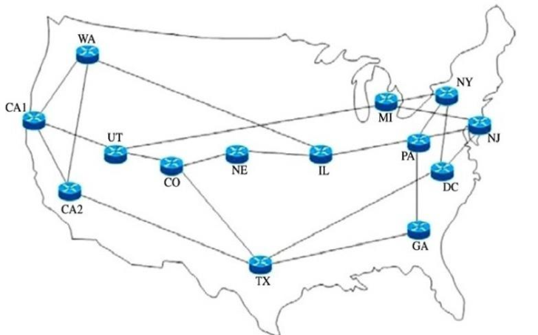
Network Routing
The second part of network resilience lies in the routing system
Routing uses a distributed computation for topology maintenance
Within each node the topology is represented as a set of all reachable destinations and an associated net-hop forwarding decision
There is no single control point and no single point of failure
The routing system detects failures and mends the connectivity fabric
NSFNET c. 1993

Slide 11
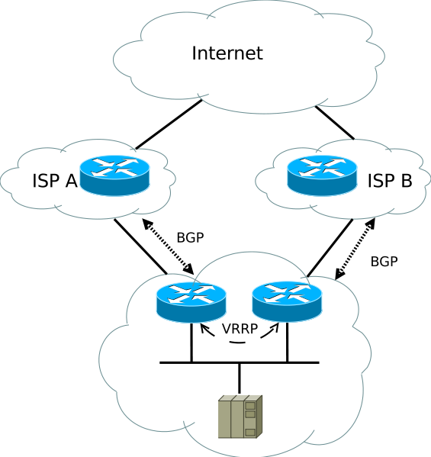
IP Resilience
How can you support resilience at the edge of the network as a customer?
  Use multiple service providers
  Announce the site’s addresses to each provider
  Import the full reachable route set from each provider

Slide 12
IP Resilience
In IPv6 we thought that a multi-homed site would use address prefixes from each upstream ISP and each internal host would have multiple IPv6 addresses
  But this presents a challenge to support seamless handover in the event of failure as active sessions need to renumber
SHIM6 was an effort in IPv6 to allow a host to exploit a network’s multiple external connections and implement transparent failover across external paths

Slide 13
Transport Resilience
TCP incorporates loss recovery and rate adaptation into the basic protocol operation
MultiPath TCP allows a host to use multiple network interfaces to load share across multiple paths – it can also support some forms of failover
QUIC allows for address agility, where a session can adjust to external network events that trigger a change in IP address
  NAT session re-binding
  Host address rebinding
HIP used similar concepts to binding a session to a shared session token, allowing the host addresses to change dynamically

Slide 14
Application Resilience
DNS resilience:
  Multiple name servers
  Multiple recursive resolvers
  Multiple IP addresses for address resource records
  Keep querying until you get an answer
Service resilience
  Service replication through anycast networks
    Anycast allows the same service IP address to be injected into the routing system at multiple points. Each client is directed to the “closest” insrtance of the service through the normal actions of the routing system
    Individual instances can be added and removed with minimal disruption

Slide 15
Engineering Resilience
The key feature of resilient engineering is to avoid single points of critical failure
This requires:
  over-provisioning of the service infrastructure to allow failover
  flexibility in the service overlay to allow dynamic reconfiguration
  Feedback-based control systems to allow for failure detection and healing

Slide 16
Engineering Resilience
We have built approaches to support resilience at the transmission level, IP level, the transport level, the session level and the application level
  Is this a case of too much? Do all of these responses trip over each other?
  Or are they each responding to different classes of potential failure modes?
  Are these systems too slow to react?
    SDH promised 50ms reaction times to primary path failure. BGP manages some 50 seconds on average to converge on a new path. The DNS may take up to 8 seconds to find a responding service.
  What are the performance targets for resilience?
  What are the costs of resilience?
  Who pays?

Slide 17
Engineering Resilience
Is is possible to position resilience as a competitive differentiator between ISPs? Or between products? Or applications?
  Yes.
  And no.

Slide 18
Internet Resilience
The internet can support highly resilient services, but there are a few preconditions to allow it to work as intended:
  Do not build single points of failure into your design
  Provision infrastructure services with redundant capacity
  Avoid stateful services

Slide 19
Thank You

